Slide 1

Customer Shopping Behavior Analysis
Uncovering actionable insights from transactional data to drive strategic business decisions.

Slide 2

Project Overview & Objectives
This project delves into customer shopping behavior using a comprehensive transactional dataset. Our primary goal is to:
Uncover Spending Patterns
Identify Customer Segments
Analyze how customers spend their money across various product categories.
Group customers based on shared behaviors and demographics.
Pinpoint Product Preferences
Optimize Subscription Strategies
Understand which products resonate most with our customer base.
Examine factors influencing subscription behavior to enhance engagement.

Slide 3
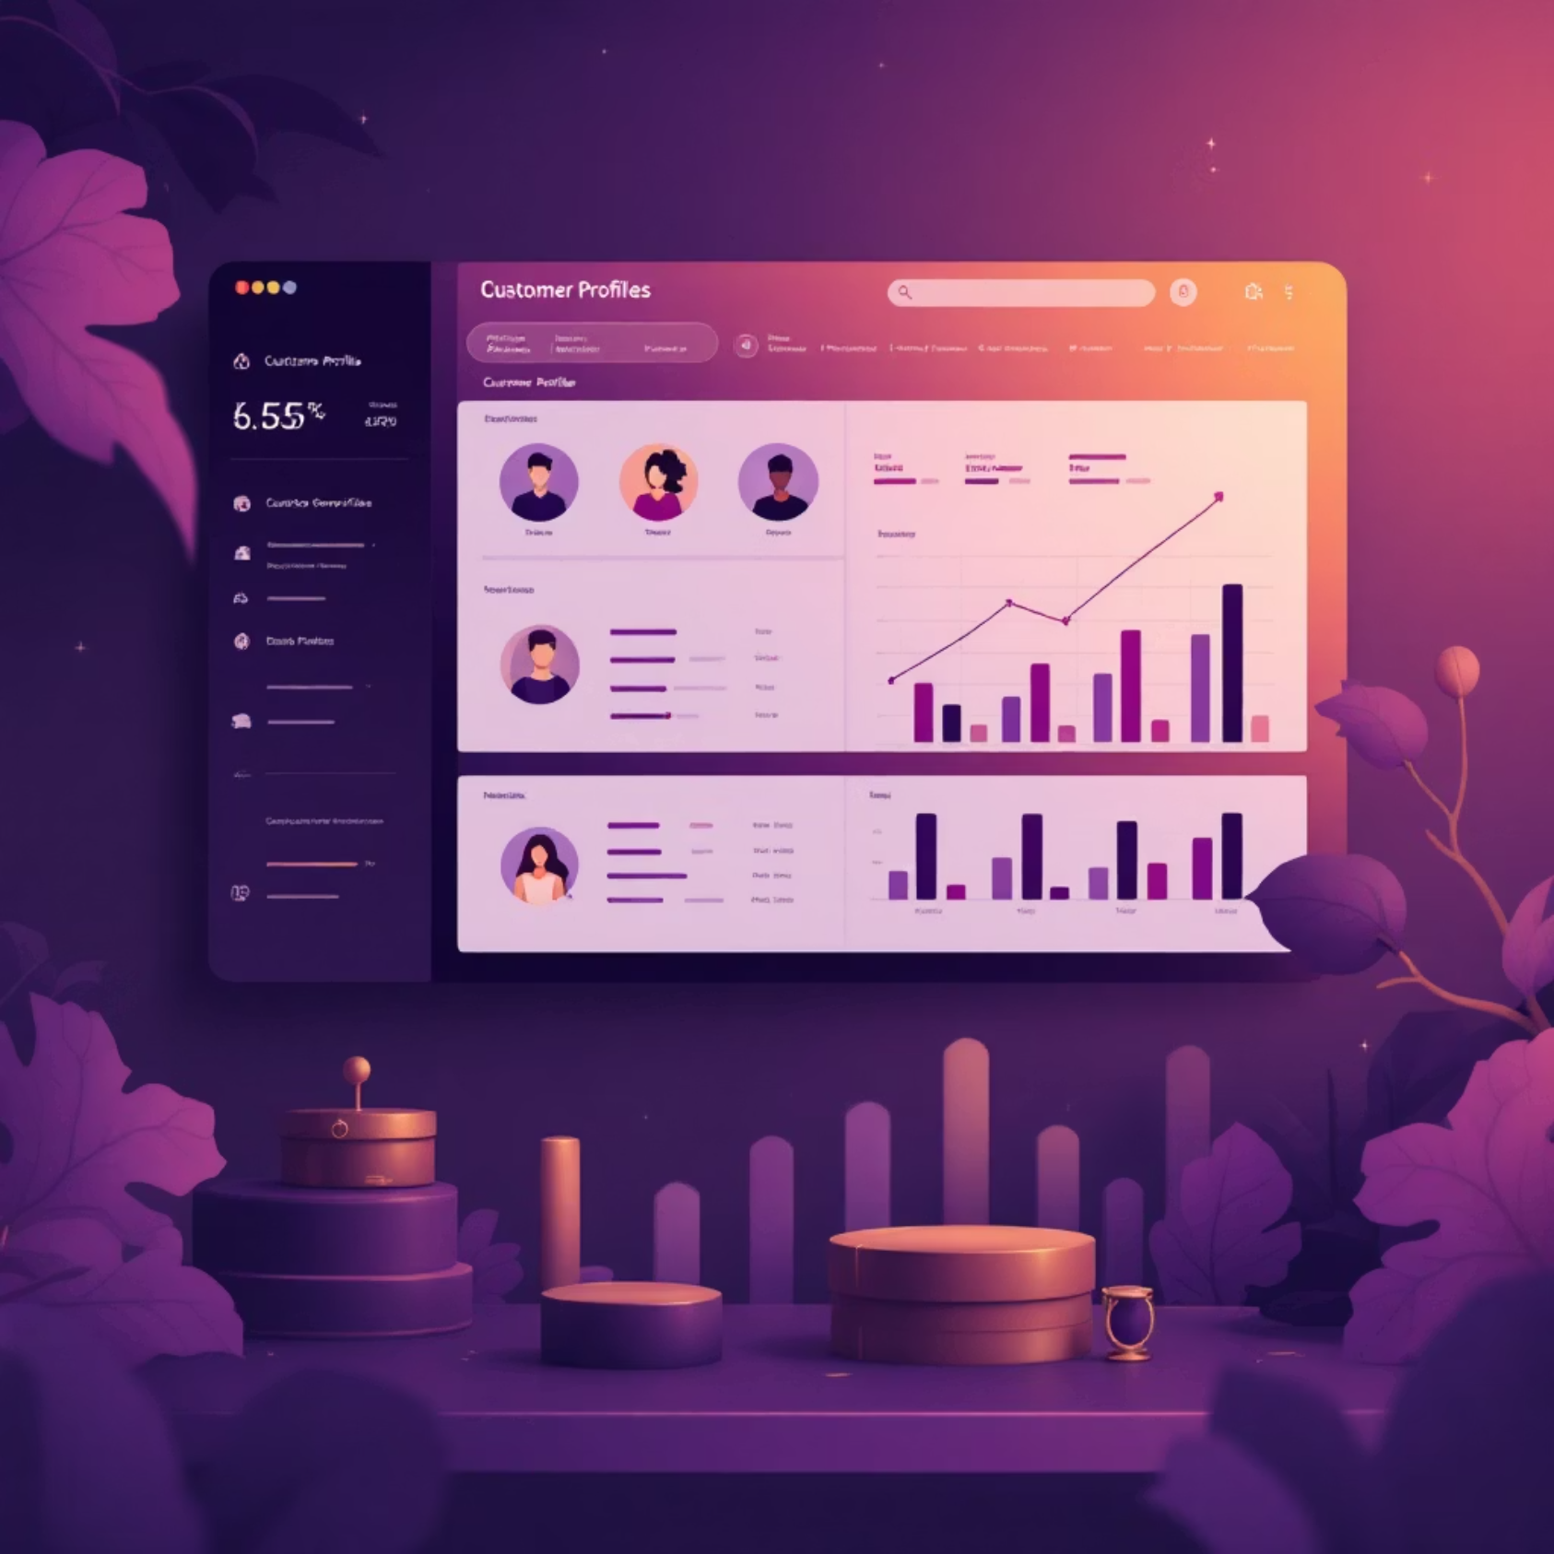
Dataset Summary: A Snapshot of 3,900 Purchases
Rows: 3,900 individual purchase records.
Columns: 18 distinct features capturing customer and transaction details.
Key Features Include:
Customer Demographics: Age, Gender, Location, Subscription Status.
Purchase Details: Item Purchased, Category, Purchase Amount, Season, Size, Color.
Shopping Behavior: Discount Applied, Promo Code Used, Previous Purchases, Frequency of Purchases, Review Rating, Shipping Type.
Missing Data: Only 37 values in the Review Rating column were missing, which were handled during cleaning.

Slide 4






Exploratory Data Analysis: Python's Role
Our journey began with meticulous data preparation and cleaning using Python, laying the groundwork for robust analysis.
Data Loading & Initial Exploration
Missing Data Handling
Column Standardization
Imputed missing 'Review Rating' values with the median rating per product category for accuracy.
Renamed columns to snake case to enhance readability and maintain consistency.
Imported the dataset with pandas and used df.info() and .describe() for initial structural and statistical insights.
Feature Engineering
Data Consistency Check
Database Integration
Created new features like age_group and purchase_frequency_days for deeper analysis.
Verified and removed redundant features like promo_code_used, streamlining the dataset.
Loaded the cleaned DataFrame into a MySQL database, preparing it for sophisticated SQL queries.

Slide 5
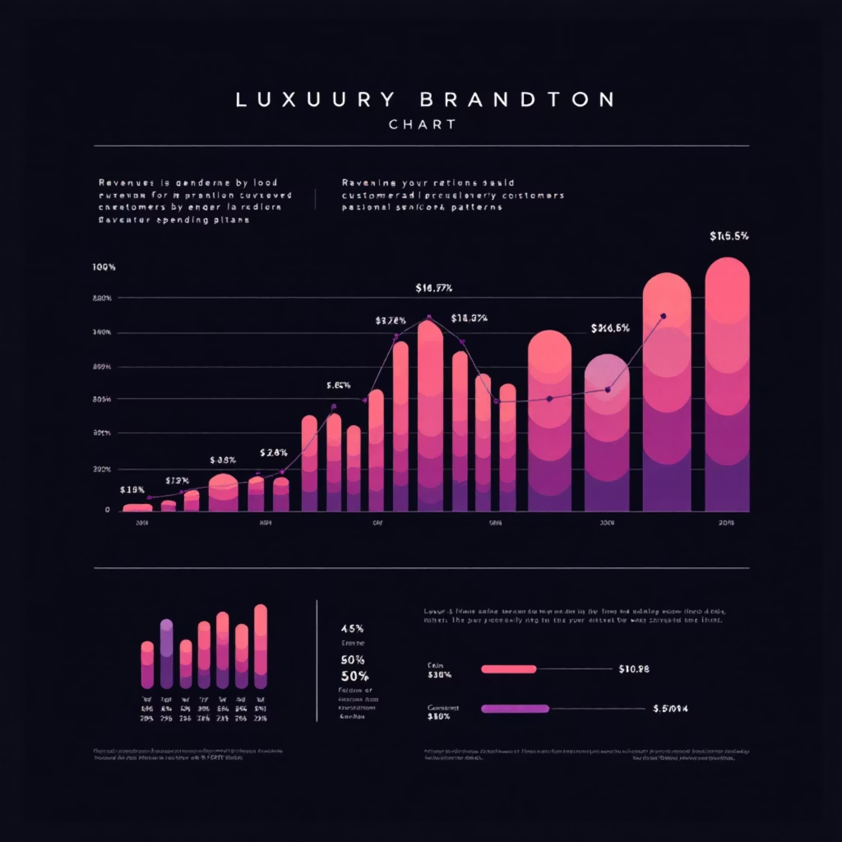
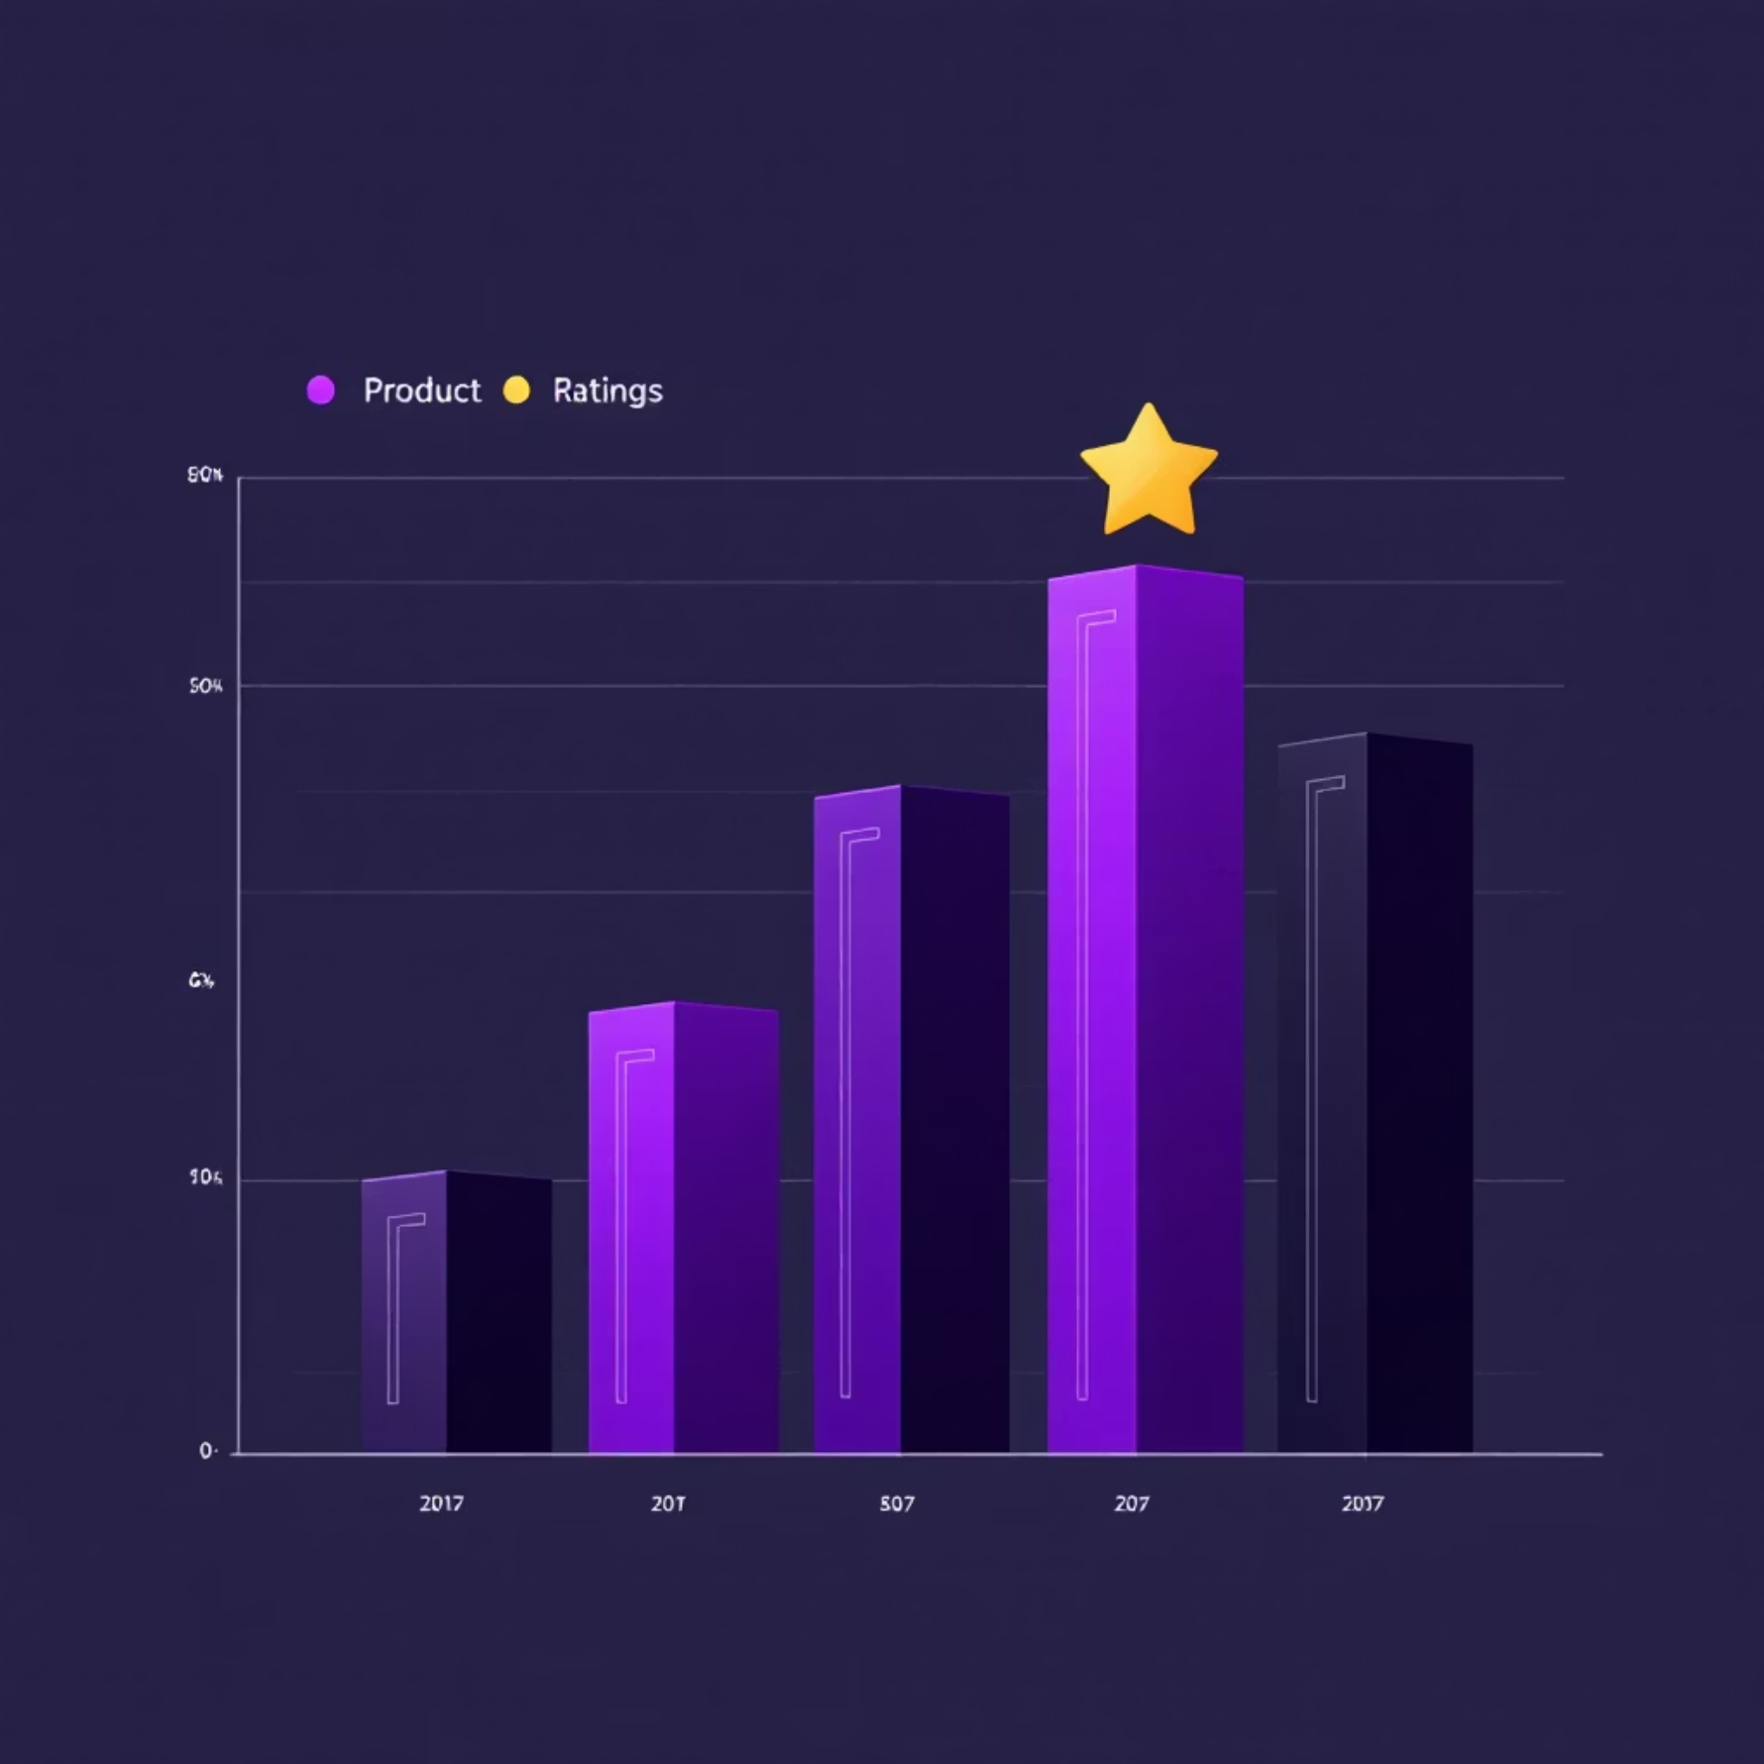
Key Insights from SQL Data Analysis
Structured analysis in PostgreSQL uncovered crucial answers to pressing business questions, providing a data-driven foundation for strategy.
Revenue by Gender
Males contributed $157,890 while Females contributed $75,191 to total revenue.
High-Spending Discount Users
Identified numerous customers who used discounts yet still spent above the average, indicating effective promotions.
Top 5 Products by Rating
Gloves (3.86), Sandals (3.85), Boots (3.82), Hat (3.8), and Handbag (3.78) received the highest average review ratings.
Shipping Type Comparison
Express shipping showed a slightly higher average purchase amount ($60.48) compared to Standard ($58.46).

Slide 6
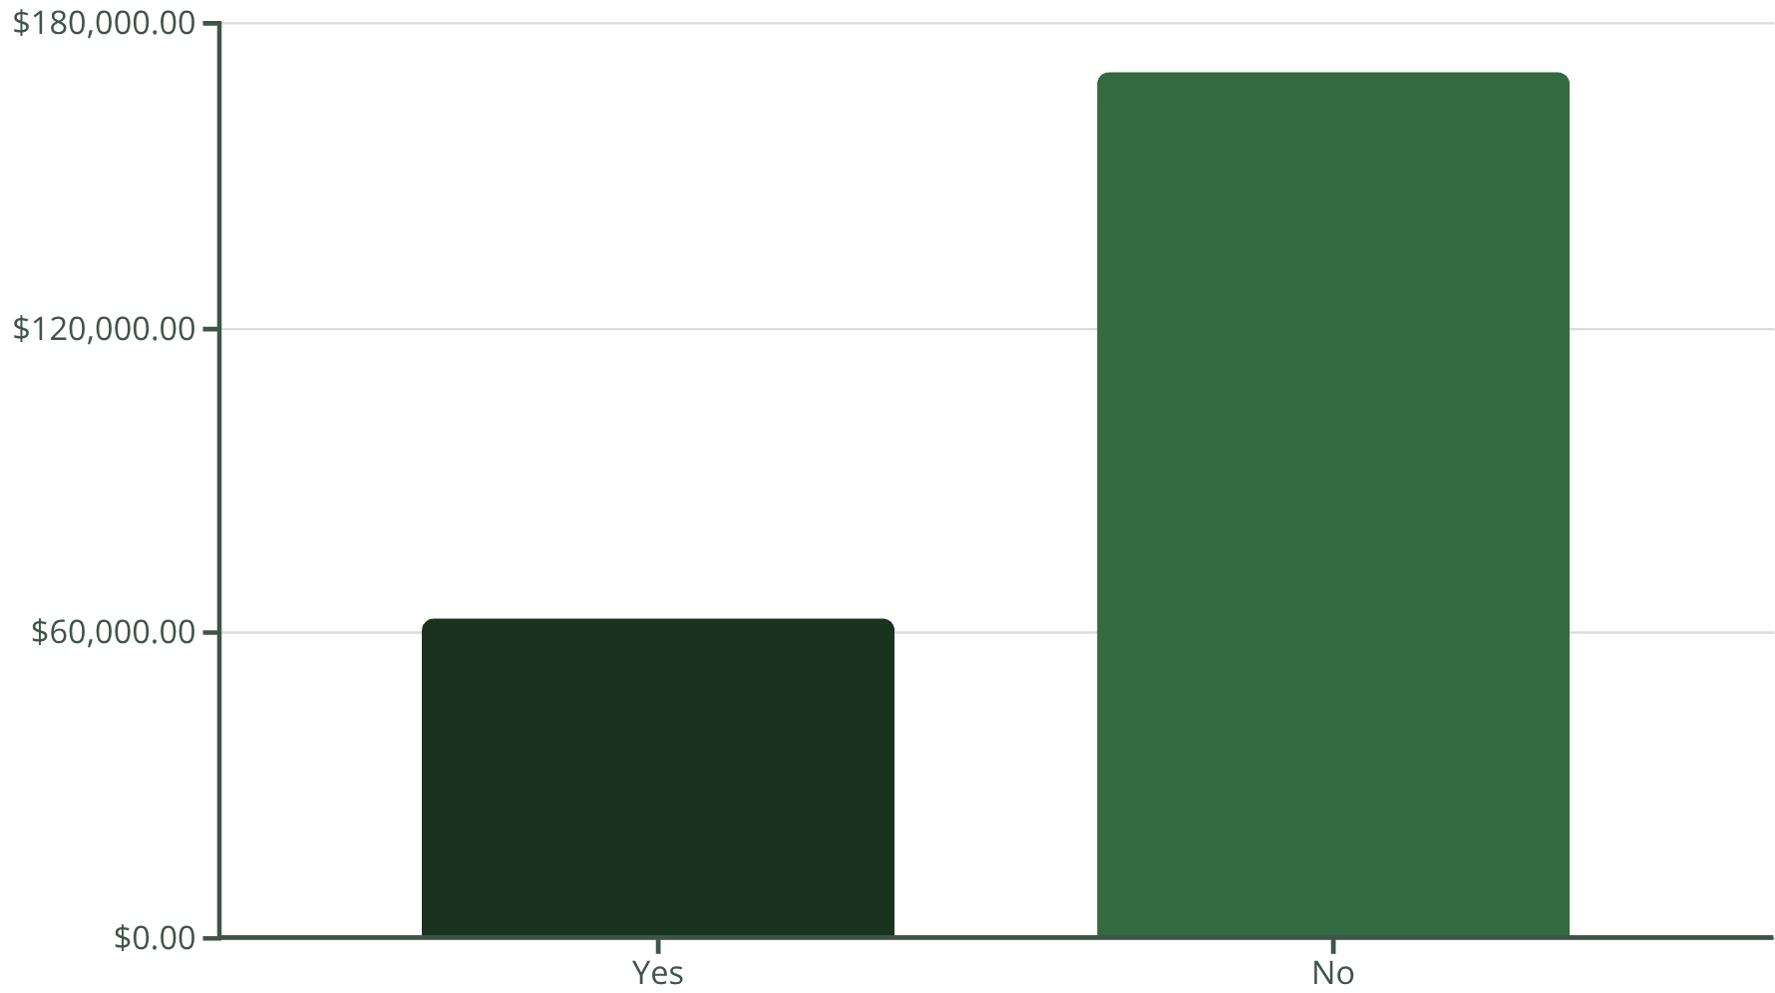
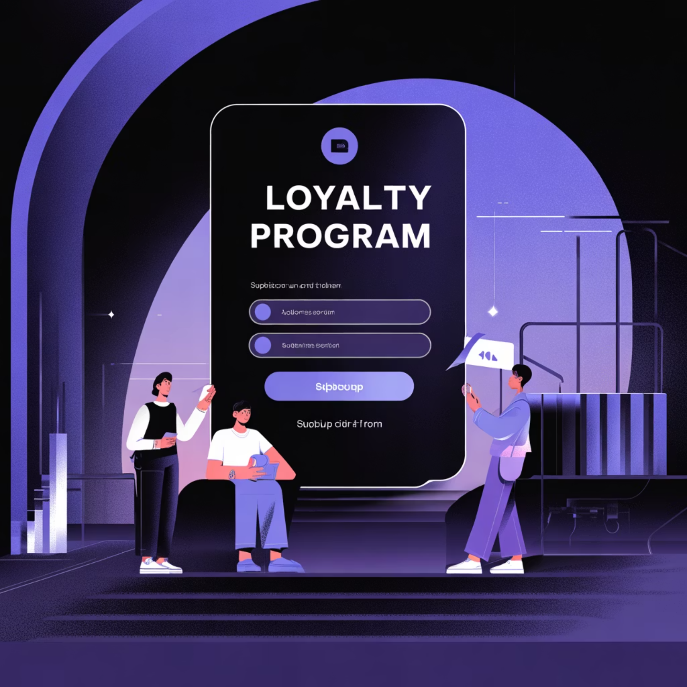
Subscription & Loyalty Deep Dive
Understanding subscriber behavior and fostering customer loyalty are critical for sustained growth.
Subscribers vs. Non-Subscribers
Subscribers (1,053 customers) generated $62,645 in revenue with an average spend of $59.49. Non-subscribers (2,847 customers) generated $170,436 with an average spend of $59.87.
Repeat Buyers & Subscriptions
Among customers with more than 5 purchases, 958 are subscribers while 2,518 are not. This suggests an opportunity to convert repeat buyers into subscribers.

Slide 7
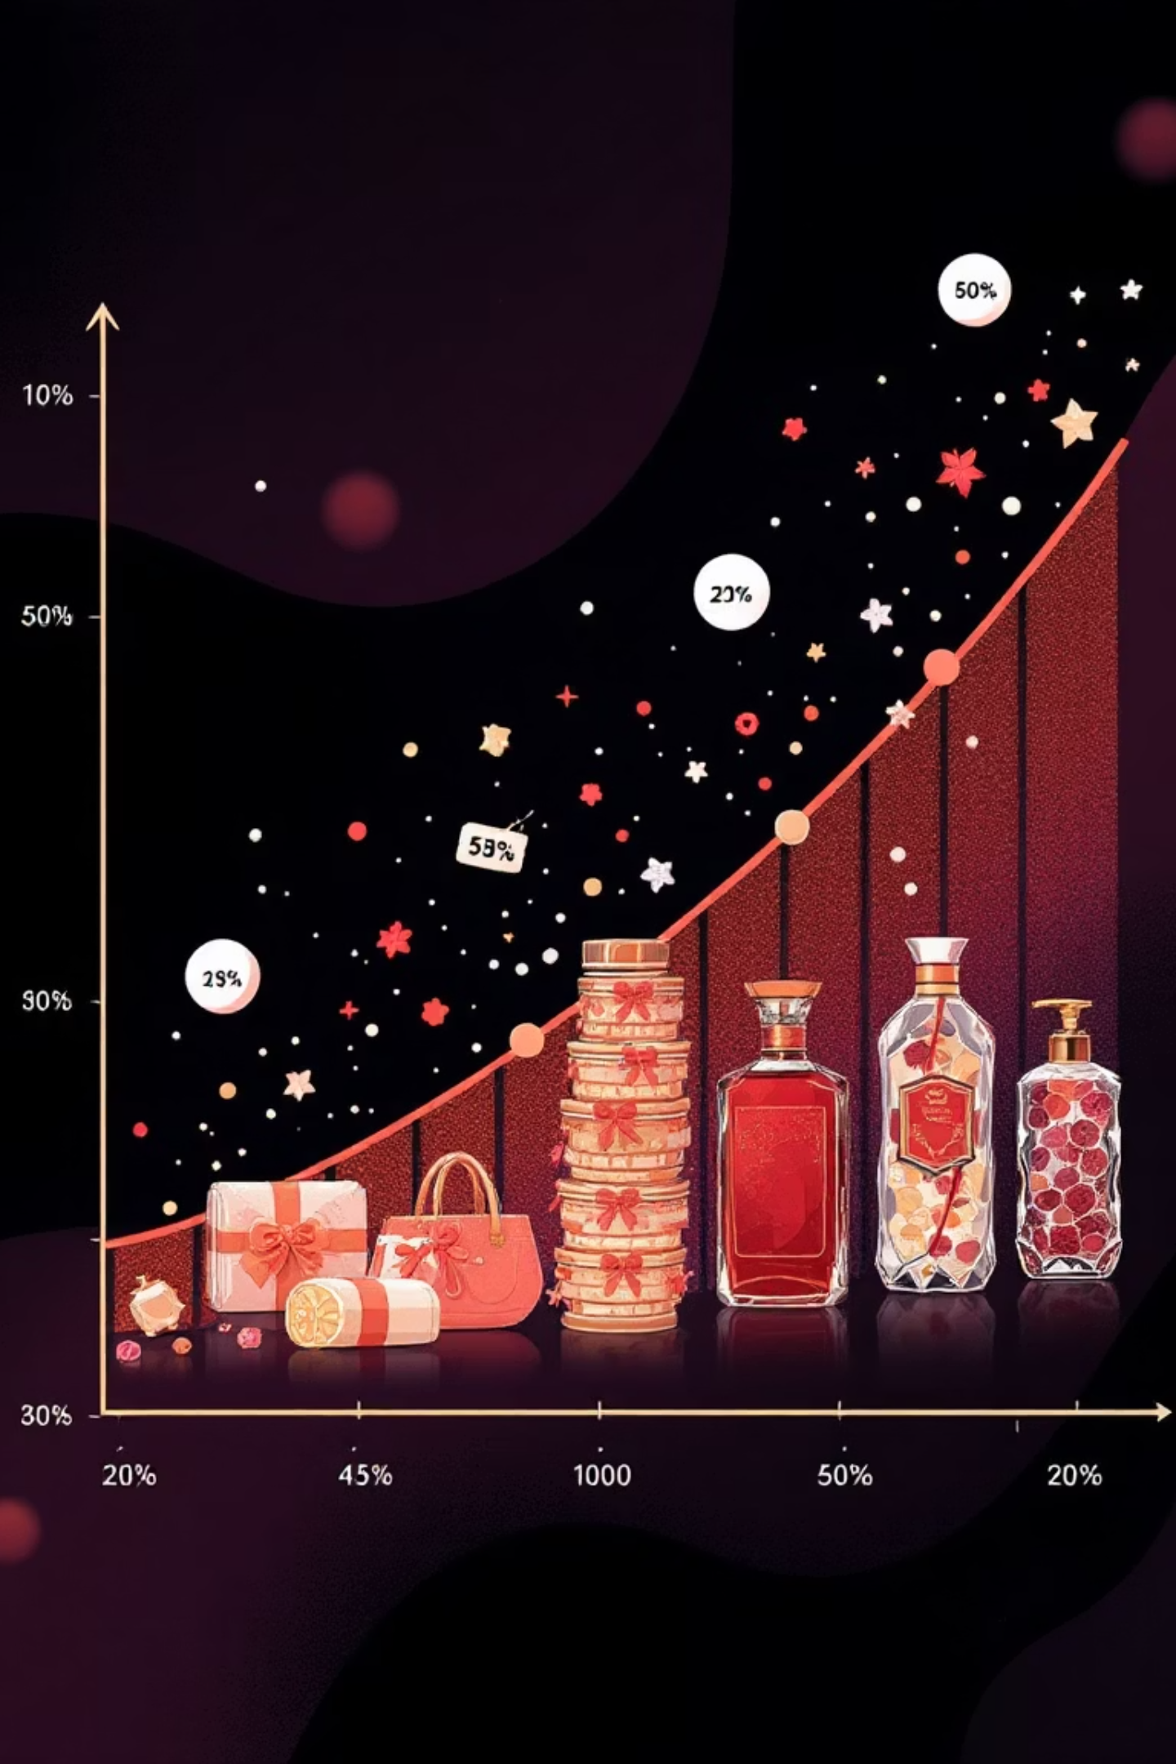

Product Performance & Discount Effectiveness
Analyzing which products benefit most from discounts and identifying top sellers within categories.
Discount-Dependent Products
Hat (50%), Sneakers (49.66%), and Coat (49.07%) showed the highest percentage of discounted purchases, indicating their sensitivity to price promotions.
Top Products per Category
Within their respective categories: Belt (Accessories, 161 orders), Shirt (Clothing, 169 orders), and Sneakers (Footwear, 145 orders) were the most purchased.

Slide 8

Customer Segmentation & Geographic Focus
Segmenting customers by purchase history and identifying high-revenue locations informs targeted marketing efforts.
Customer Segmentation
Top 10 Cities by Revenue
Customers were categorized into:
Montana, Illinois, California, Idaho, Nevada, Alabama, New York, North Dakota, West Virginia, and Nebraska were the highest revenue-generating cities, led by Montana with $5,784.
Loyal: 3,279 customers
Returning: 538 customers
New: 83 customers
This breakdown helps tailor engagement strategies for each group.

Slide 9

Power BI Dashboard: Visualizing Insights
An interactive Power BI dashboard brings all key insights to life, providing a dynamic tool for business stakeholders.
$233K Total Revenue
3.9K Customers
3.75 Average Review Rating
$60 Average Purchase
The dashboard highlights revenue by category (Clothing leading with $104K), top-selling items, and revenue contributions from various age groups and locations, offering a holistic view of customer behavior.

Slide 10
Actionable Business Recommendations
Leveraging these insights, we propose strategic recommendations to enhance customer engagement and optimize business performance.
1
Boost Subscriptions
Implement targeted campaigns highlighting exclusive benefits to increase subscriber conversion and retention.
2
Customer Loyalty Programs
Develop tiered loyalty programs to reward repeat buyers, incentivizing their progression into the "Loyal" segment.
3
Review Discount Policy
Analyze the long-term impact of discounts to ensure they drive sales without compromising profit margins. Test different promotional strategies.
4
Product Positioning
Feature top-rated and best-selling products prominently in marketing campaigns and on the website to capitalize on their popularity.
5
Targeted Marketing
Focus marketing efforts on high-revenue age groups and regions, and consider personalized offers for express-shipping users to maximize impact.

